Slide 1







PROJECTS | PRODUCTS | COURSE | INTERNSHIP
info@discoverprojects.com
www.discoverprojects.com
pro.aiskool@gmail.com
www.aiskool.com
Shop no. 2, Narayan Smurti Building, Opp. Saraswati Book Depot,
Near CIDCO Bus Stop, Thane West, India.
+91 9967478289 / +91 9167769993

Slide 2

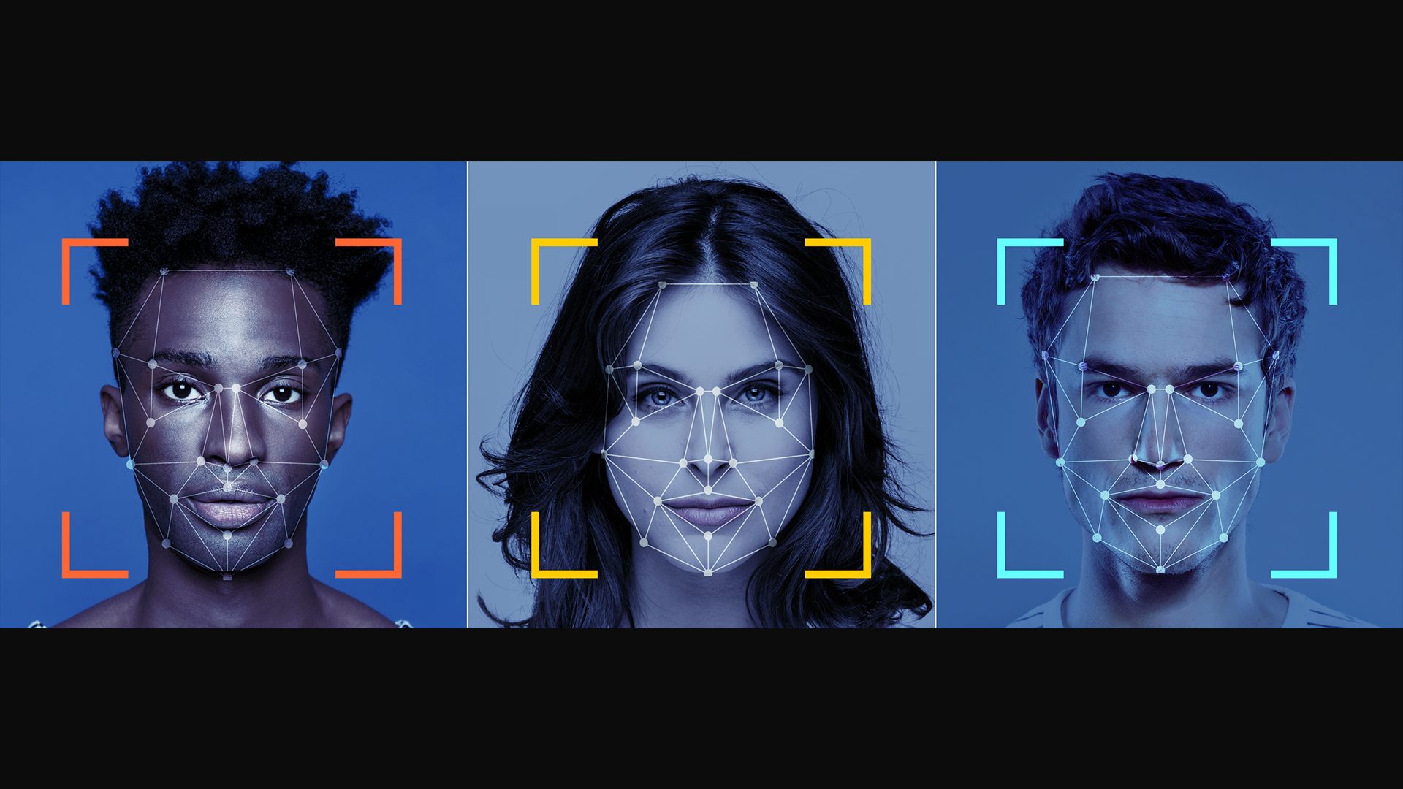
Facial Recognition
Relevant Image

Slide 3
Introduction and Application
The objective is build a machine to recognise the facial expressions of the person in the image provided using SVM.
The objective of the support vector machine algorithm is to find a hyperplane in an N-dimensional space(N — the number of features) that distinctly classifies the data points.

Slide 4
Working
FIRST STEP WAS TO COLLECT DATA FROM DIFFERENT SOURCES FOR OUR PROBLEM STATEMENT .
THEN WE HAVE TO CLEAN , PROCESS CATEGORICAL DATA AND NORMALISE IT.
THEN WE SHOW VARIOUS ANALYSIS USING GRAPHS.
SPLIT THE DATA INTO TRAINING AND TEST SET.
SELECT AN ALGORITHM.
FITTING THE MODEL TO TRAINING SET.
SAVING THE MODEL
CHECK ACCURACY OF TRAINED DATA W.R.T TRAIN SET.
TEST THE TRAINED MODEL W.R.T TESTING SET.
CHECK ACCURACY OF TEST DATA W.R.T TEST SET.
BASED ON THE GENERATED GRAPHS WE RECOGNISE THE EXPRESSIONS OF THE FACE.

Slide 5
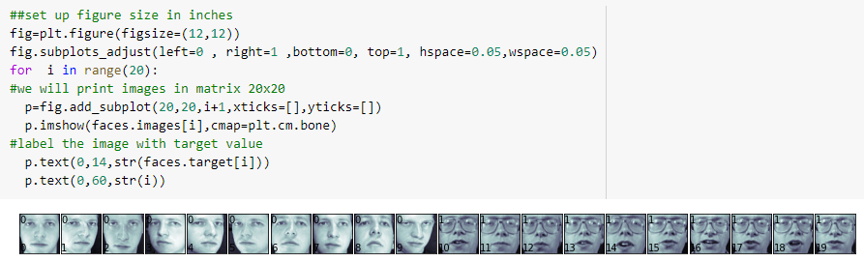
Working and Building
This is the data that we are using in the recognition of face expressions The source of dataset is sklearn.datasets.

Slide 6

Handling Categorical Data
The objective of a Linear SVC (Support Vector Classifier) is to fit to the data you provide, returning a "best fit" hyperplane that divides, or categorizes, your data. From there, after getting the hyperplane, you can then feed some features to your classifier to see what the "predicted" class is.

Slide 7
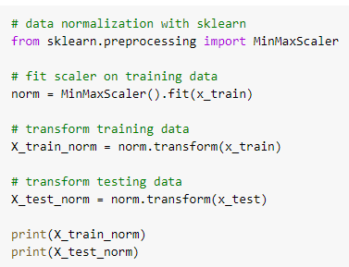
Normalise Data
MinMaxScaler transforms features by scaling each feature to a given range.
fit(self, X[, y]):
Compute the minimum and maximum to be used for later scaling.
transform(self, X):
Scale features of X according to feature_range.

Slide 8

Graphs
Here we have created a graph for data using matplotlib library of Python.
figsize():
width, height in inches.
tight_layout():
automatically adjusts subplot params so that the subplot(s) fits in to the figure area.
seaborn.distplot():
Flexibly plot a univariate distribution of observations.

Slide 9

Splitting Data
Python has a library sklearn which contains a function ‘train_test_split’. This function is used to Split arrays or matrices into random train and test subsets.
test_size float or int, default=None:
If float, should be between 0.0 and 1.0 and represent the proportion of the dataset to include in the test split. If int, represents the absolute number of test samples. If None, the value is set to the complement of the train size. If train_size is also None, it will be set to 0.25.
random_state int or RandomState instance, default=None
Controls the shuffling applied to the data before applying the split. Pass an int for reproducible output across multiple function calls.

Slide 10
Selecting Algorithm
WE ARE USING THE SVM ALGORITHM.

Slide 11
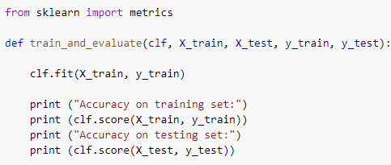
Fitting the model to trained dataset
We have used the fit() function to fit our model to the training dataset and hence passed the parameters for the same.

Slide 12
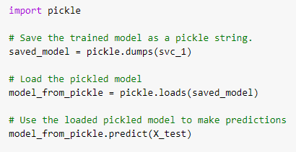
Saving the model
We can use the Pickle library in Python to save our model. In this code we can see that the model has been saved as a string.
So, first we save the model as a string, then we load it and use it to make predictions.

Slide 13

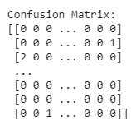
Confusion Matrix
Confusion Matrix function is present in the sklearn library of Python. A confusion matrix is a table that is often used to describe the performance of a classification model (or “classifier”) on a set of test data for which the true values are known. It allows the visualization of the performance of an algorithm.

Slide 14
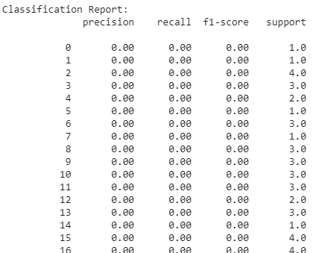
Precision, Recall, Support, Fscore
The precision is intuitively the ability of the classifier not to label as positive a sample that is negative. The recall is intuitively the ability of the classifier to find all the positive samples.The F-beta score can be interpreted as a weighted harmonic mean of the precision and recall, where an F-beta score reaches its best value at 1 and worst score at 0.The support is the number of occurrences of each class in y_true. We have used the classification_report() function for the same.
**In the same way we will calculate the confusion matrix, precision, recall, support and fscore for the test dataset.**

Slide 15

Prediction
We have used the predict() function for making the predictions on our model.

Slide 16
Evaluate, Tune and Improve Neural Network
score(X,Y) internally calculates Y'=predictor.predict(X) and then compares Y' against Y to give an accuracy measure. This applies not only to logistic regression but to any other model.
We have used this function for calculating accuracy of our model.

Slide 17

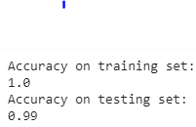
Calculating Efficiency:

Slide 18
FAQ
When is SVM used?
SVM is a supervised machine learning algorithm which can be used for classification or regression problems. It uses a technique called the kernel trick to transform your data and then based on these transformations it finds an optimal boundary between the possible outputs.
What makes SVM unique?
Well SVM it capable of doing both classification and regression.The benefit is that you can capture much more complex relationships between your datapoints without having to perform difficult transformations on your own. The downside is that the training time is much longer as it's much more computationally intensive.

